Slide 1
Air pollution Analysis
in United States
From 2016
to 2021
Team Members
Vrushali Ponkia (N01530336)
Janki Patel (N01533282)

Slide 2
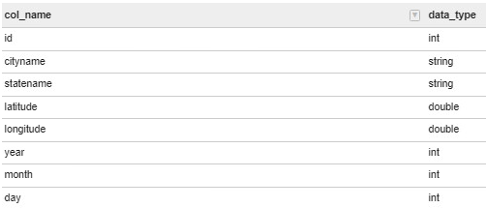
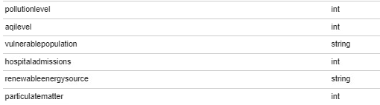
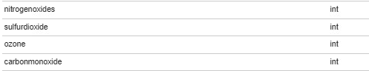
Overview of dataset
(6056 * 18)

Slide 3
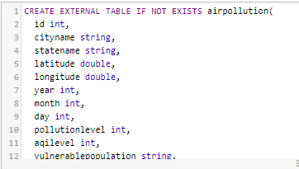
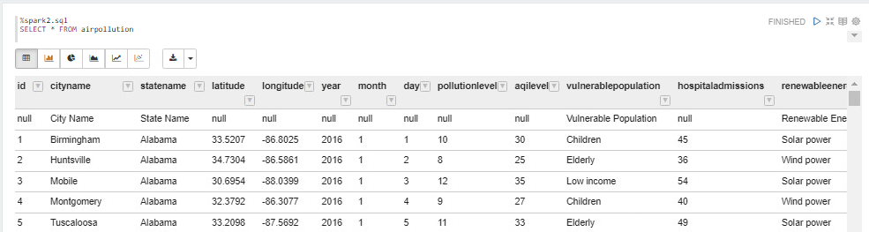
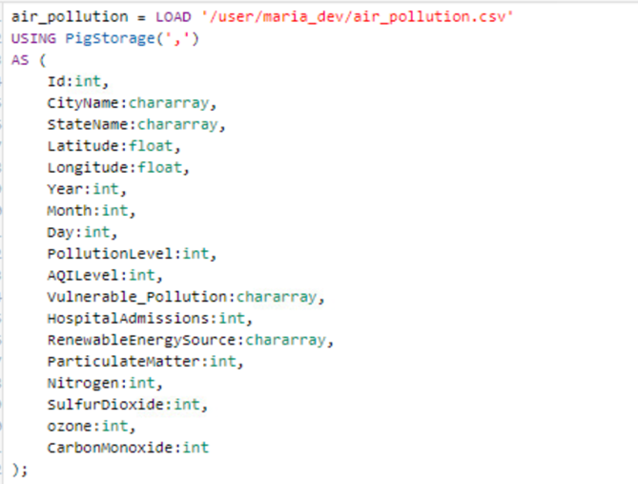
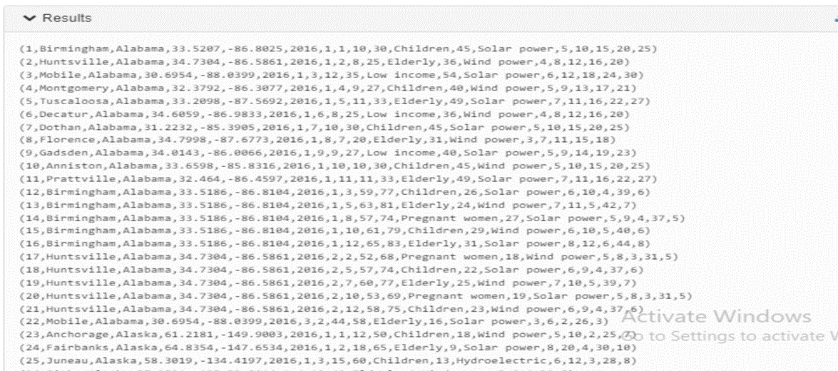
Loading data from hdfs to hive to zeppelin and hdfs to Pig
Hive to zeppelin
Output of pigstorage

Slide 4
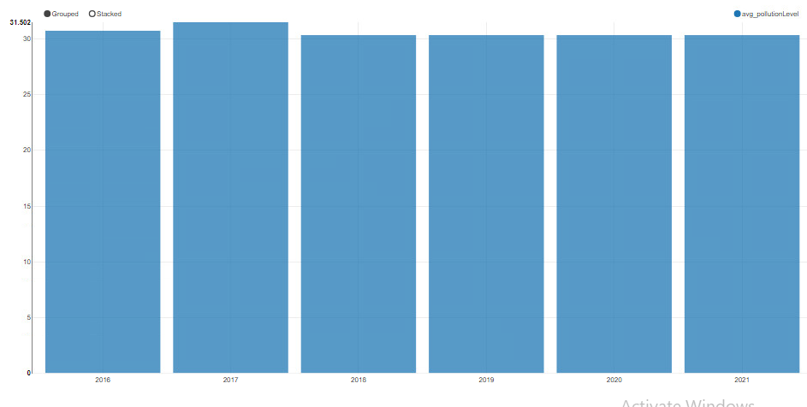
Yearly Trends of Air Pollution

Slide 5
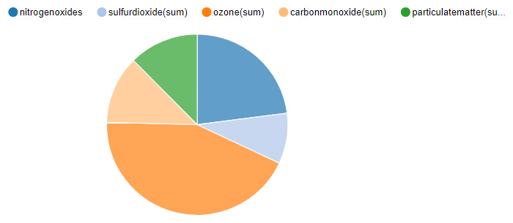
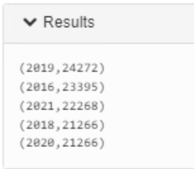
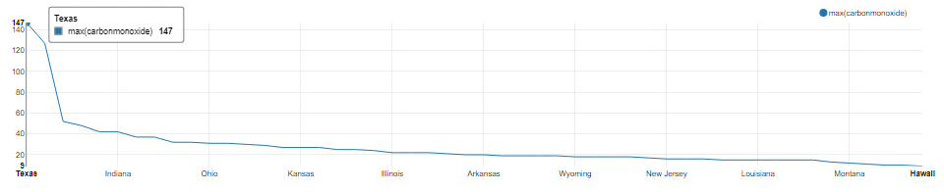
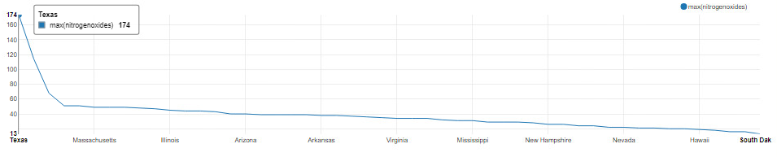
Causes of Air Pollution
12%
( Year, ozone)
23%
12%
9%
43%

Slide 6
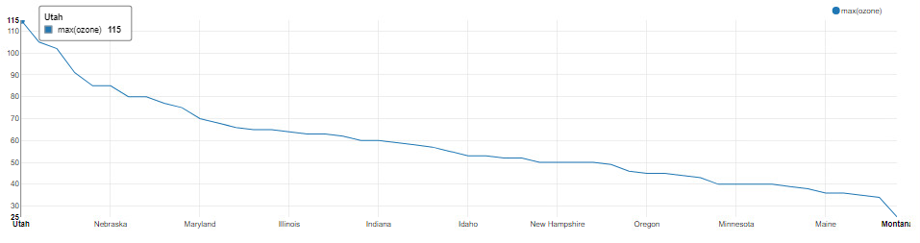
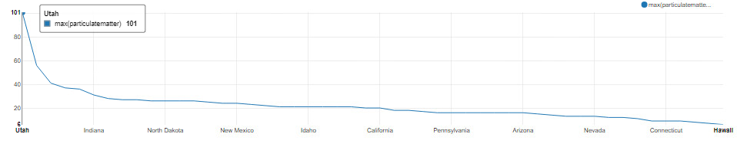
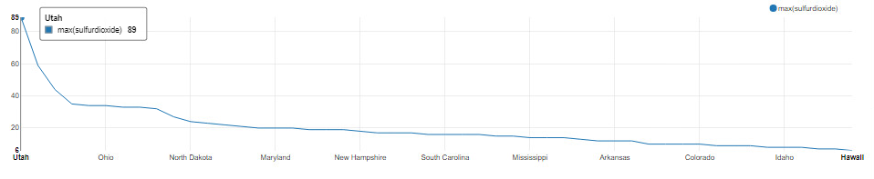
Causes of Air Pollution

Slide 7
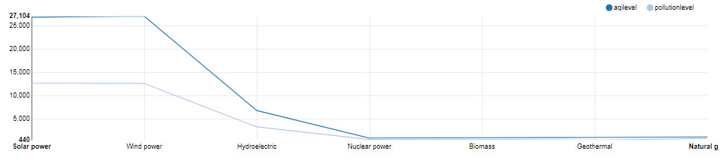
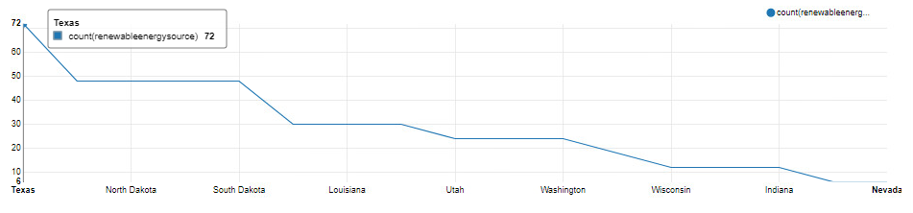
Benefits of Using Renewable Energy Sources

Slide 8
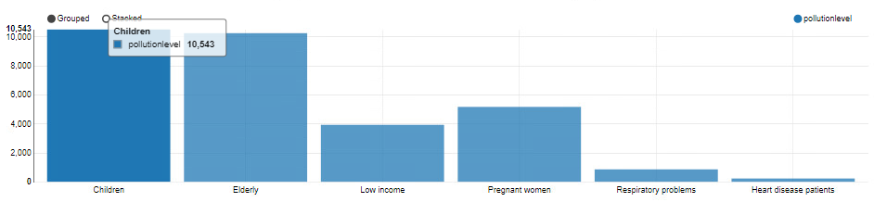
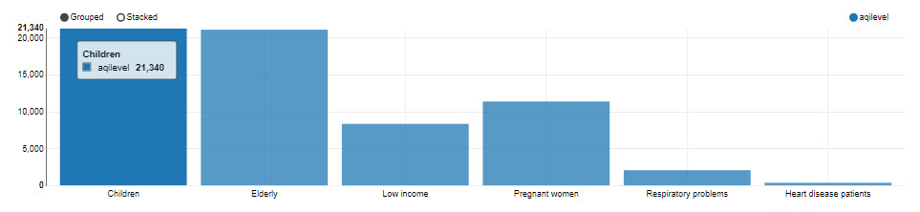
Identifying the Most Vulnerable Population to Air Pollution

Slide 9
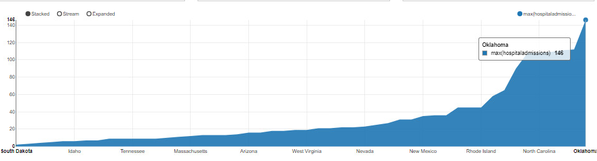
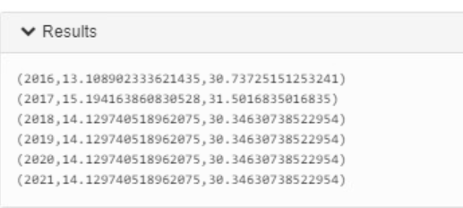
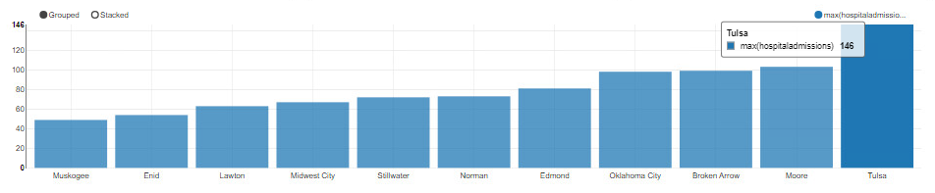
Impacts of Air Pollution on Hospital Admissions
( Year, hospital admission, pollution level )

Slide 10
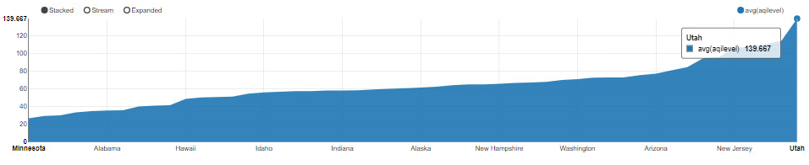
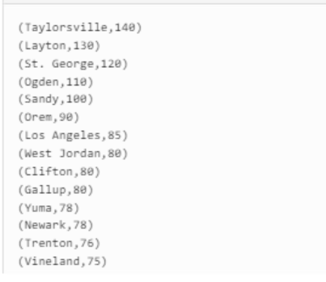
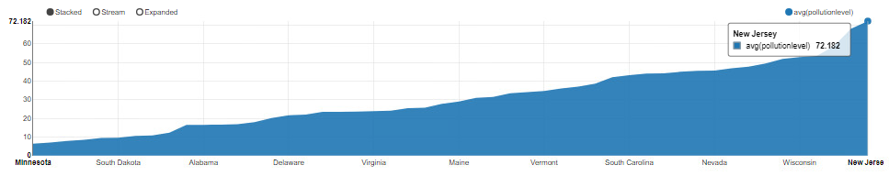
State with the Highest Air Pollution & Poor Air Quality

Slide 11
Conclusion
Uniform pollution levels persisted
throughout the specified timeframe,
with a slight increase in 2017.
Meanwhile, Utah recorded the highest level of air pollution, but it could be
made better by using renewable
energy like Texas does.

Slide 12
THANK YOU

